Slide 1
BUILDING END-To-END PIPELINE
Group5
Dereck MinThu, Joseph Zhou, Lakshmi, Tk Choi, Wendy Chung

Slide 2
Agenda
Data Source
Overall Architecture
Data Ingestion
Data Warehouse
Data Transformation
Pipeline Automation
Data Testing
Exploratory Data Analysis (EDA)
Insights

Slide 3
Data Source

Slide 4
This is a Brazilian ecommerce public dataset of orders made at Olist Store. The dataset has information of 100k orders from 2016 to 2018 made at multiple marketplaces in Brazil.
Data Source - Brazilian E-Commerce Dataset by Olist https://www.kaggle.com/datasets/olistbr/brazilian-ecommerce
Dataset excluded,
olist_order_reviews_dataset.csv

Slide 5
Overall Architecture

Slide 6
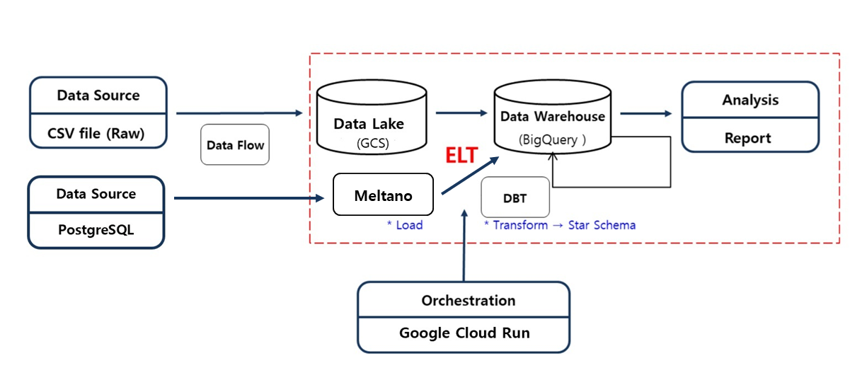

Slide 7
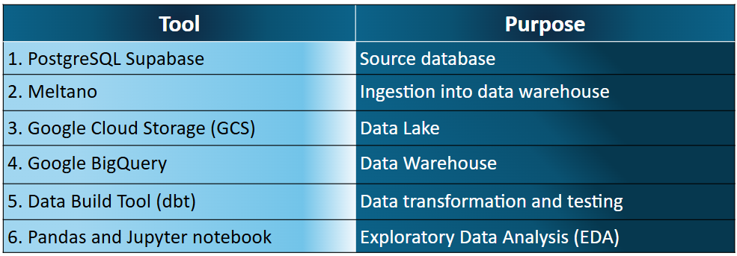
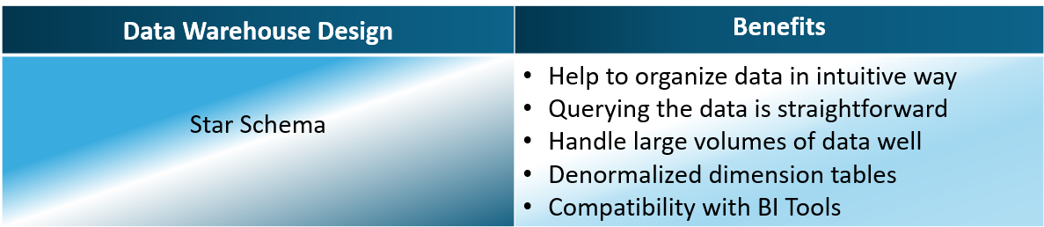

Slide 8
Data Ingestion

Slide 9
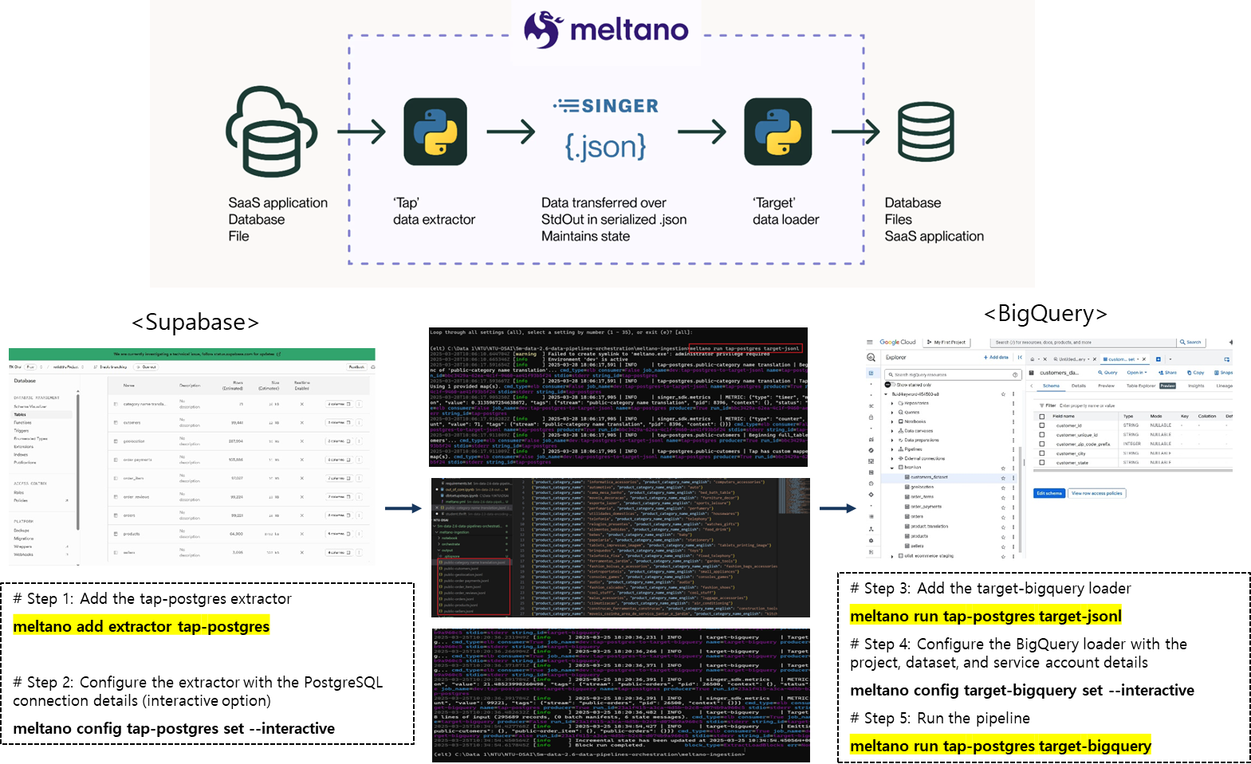
Loading csv file by using Meltano (Method 1)

Slide 10
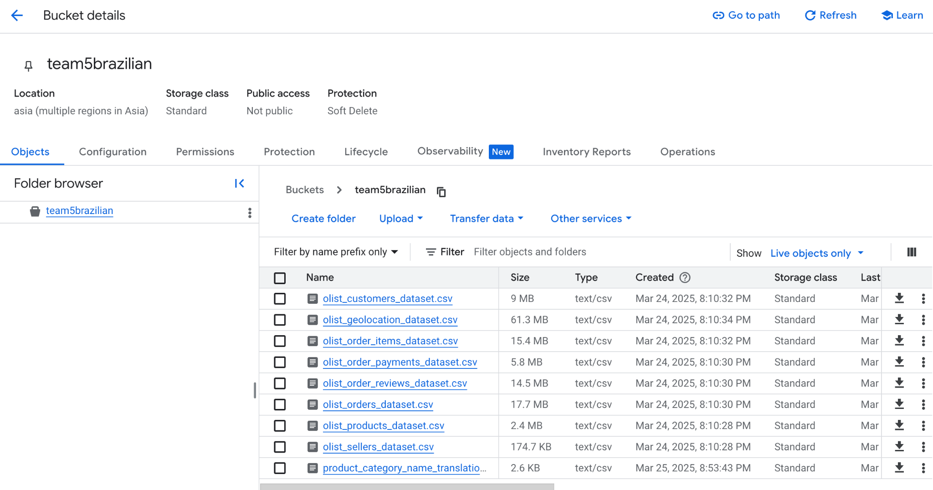
Loading csv into team5brazilian GC Bucket (Method 2)

Slide 11
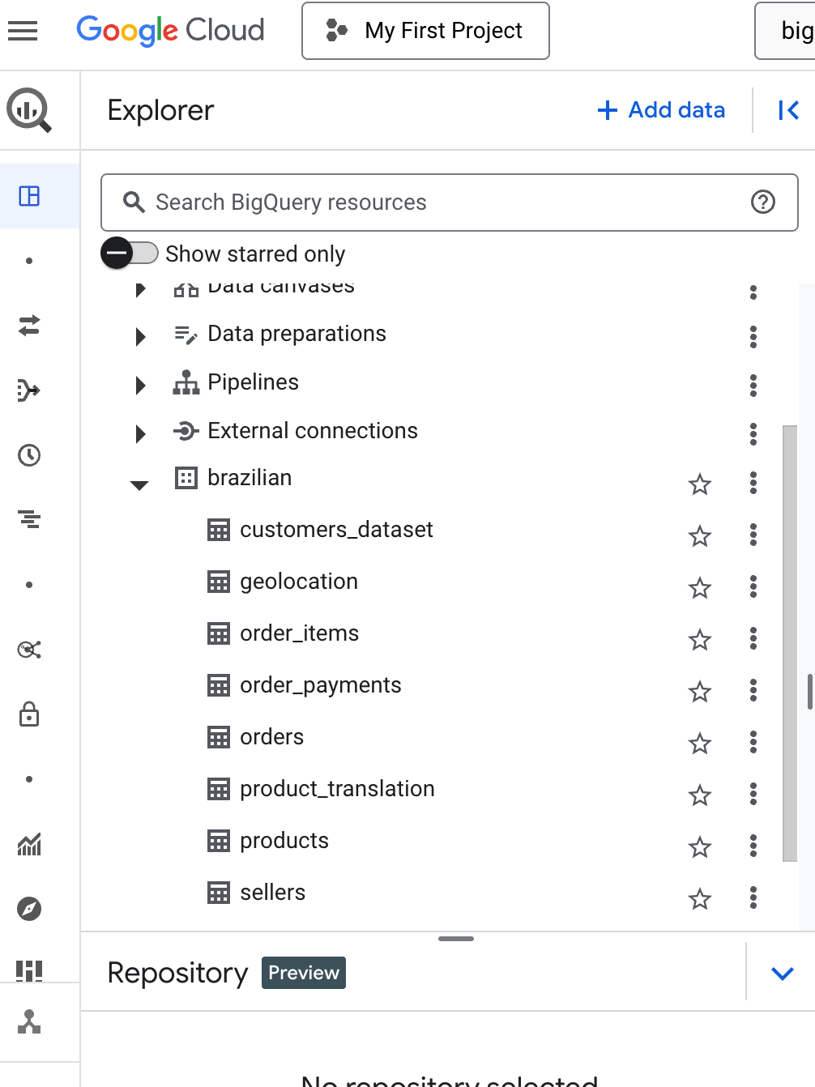
Import the csv files into GC BigQuery

Slide 12
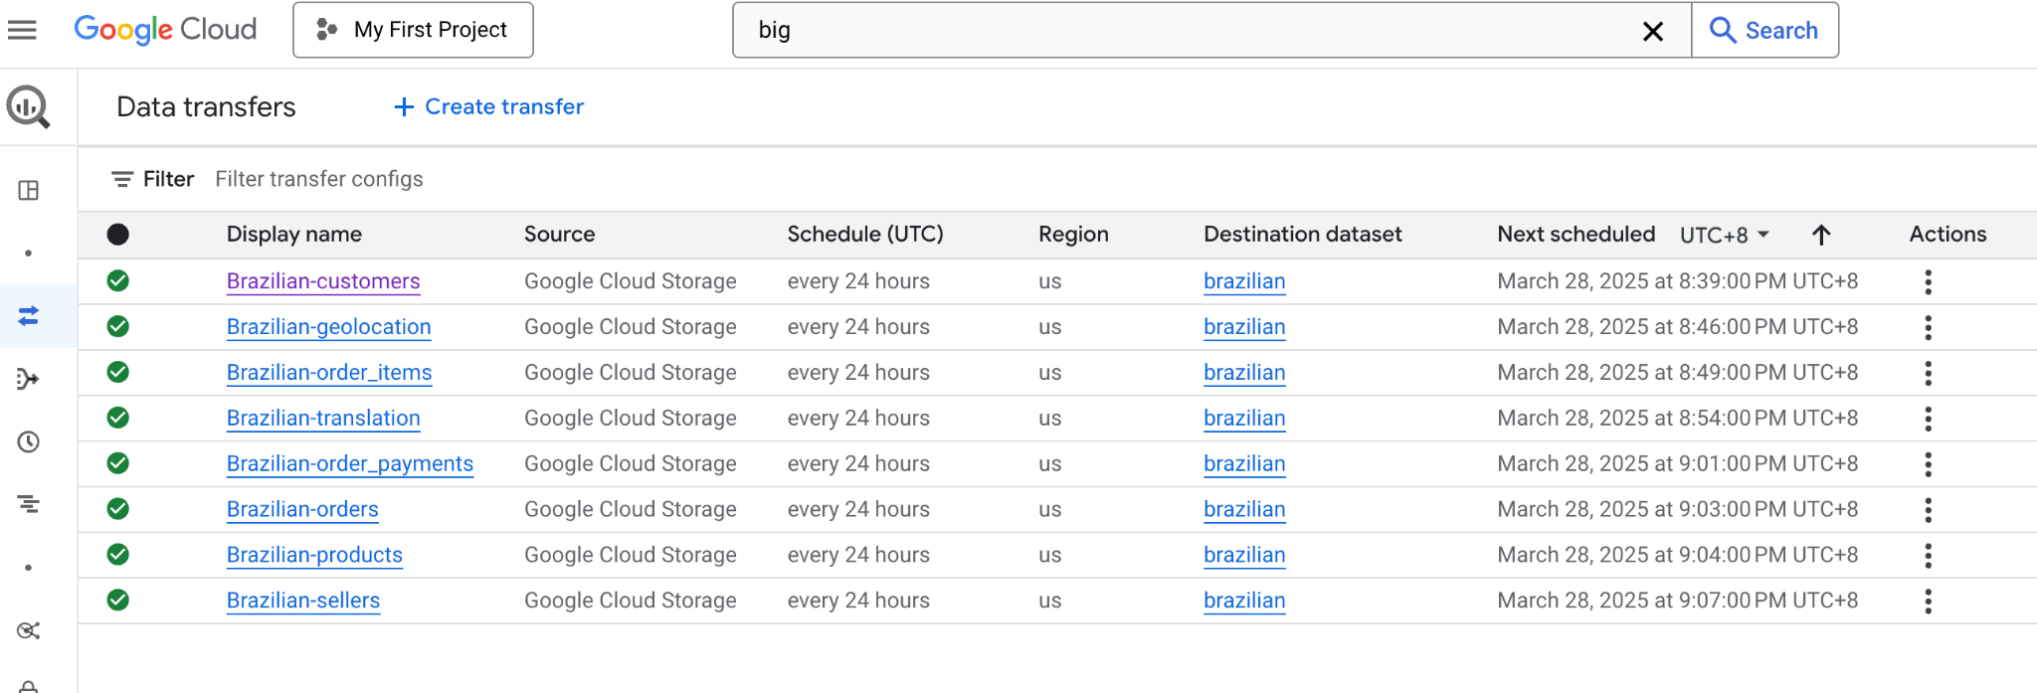
Create Data Transfer in GC BigQuery (Automation)

Slide 13
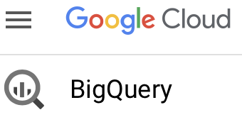
Data Warehouse

Slide 14
Staging Schema
Our raw data resides in Google BigQuery under the dataset named brazilian - used to stage the data
Key tables we've utilized include:
customers: Contains customer information.
geolocation: Provides geographic coordinates for zip codes.
order_items: Details each item within an order.
order_payments: Contains payment information for orders.
order_reviews: Holds customer reviews for orders.
orders: Contains high-level order information.
product_category_name_translation: Provides English translations for product category names.
products: Contains product details.
sellers: Provides information about the sellers.

Slide 15
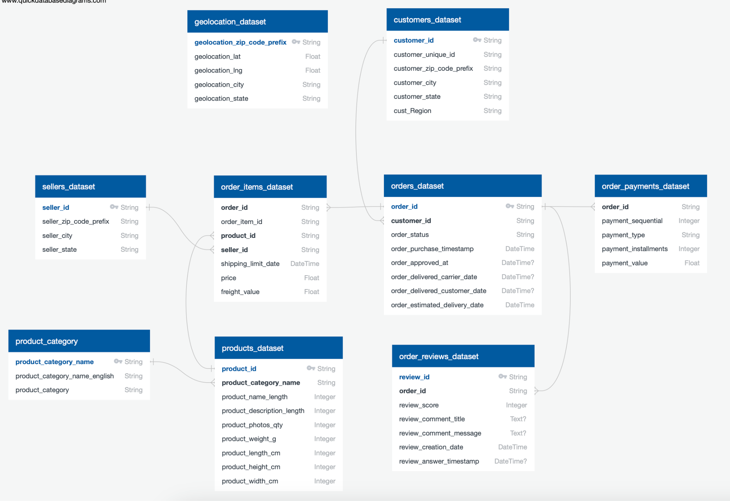
Staging Area ERD

Slide 16
Star Schema
We've implemented a star schema to analyze our Brazilian e-commerce data.
The core of our design is the fct_order_items fact table, which records details about each item in an order.
This table has been chosen as the fact table due to its granularity
Surrounding the fact table are several dimension tables, providing context and attributes for analysis.

Slide 17
Fact Table -fct_order_items
Each row in fct_order_items represents a single item within an order.
Key Measures:
price: The price of the individual order item.
freight_value: The shipping cost for the individual order item.
order_total: The total value of the entire order (calculated and included for convenience).
Foreign Keys: These columns link each order item to its related dimensions:
order_id (references dim_orders)
product_id (references dim_products)
seller_id (references dim_sellers)
customer_id (derived from dim_orders and references dim_customers)

Slide 18
Dimension Tables
dim_customers: Provides information about the customers who placed the orders. Key attributes include customer_id(primary key), customer_unique_id, customer_city, and customer_state.
dim_orders: Contains details about each order. Key attributes include order_id (primary key), order_status, order_purchase_timestamp, and other relevant dates.
dim_products: Describes the products that were ordered. Key attributes include product_id (primary key), product_category_name, and product_category_name_english.
dim_sellers: Provides information about the sellers who listed the products. Key attributes include seller_id(primary key), seller_city, and seller_state.
dim_order_payments: Details the payment information for each order. Key attributes include order_id (foreign key), payment_type, payment_value, and payment_installments.
dim_order_reviews: Contains customer reviews for each order. Key attributes include review_id (primary key), order_id (foreign key), review_score, and review comments.

Slide 19
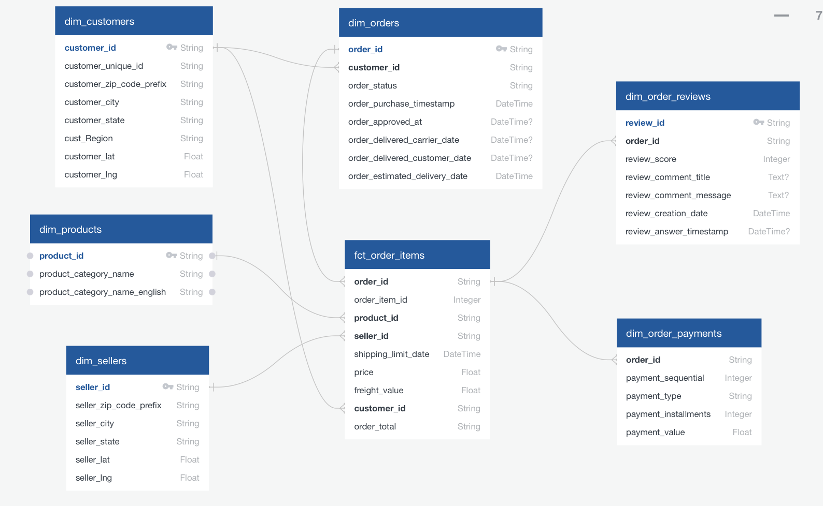
Star Schema ERD

Slide 20

Data Transformation

Slide 21
Initialising the DBT project
Install DBT core pip install dbt-core
Install dbt Adapter for big Query pip install dbt-bigquery
Navigate to the folder location and run in terminal
> dbt init brazilian_ecommerce
This will create the necessary folder structure for the project with above name
Test your BigQuery Connection within your project folder
> dbt debug

Slide 22
Configuration : Profiles.yml and sources.yml
brazilian_ecommerce:
outputs:
dev:
dataset: olist_star_schema
job_execution_timeout_seconds: 300
job_retries: 1
location: US
method: oauth
priority: interactive
project: fluid-keyword-454503-a8
threads: 1
type: bigquery
target: dev
Defined the raw data sources (e.g., customers, orders, products) from the brazilian dataset in BigQuery using sources.yml
This goes into profiles.yml

Slide 23
Organizing Our Models
Created a structured directory under the models folder:
dimensions: For dimension tables.
facts: For the fact table
Dimension Table Creation
dim_customers: Created a dimension table for customer information, including optional integration with geolocation data.
dim_orders: Created a dimension table for order-level details,
dim_products: Created a dimension table for product information, joining with product translation data to include English category names.
dim_sellers: Created a dimension table for seller information, including optional integration with geolocation data.
dim_order_payments: Created a dimension table for order payment details.
Fact Table Creation
fct_order_items: Created a fact table to represent individual items within each order, linking to the dimension tables (dim_orders, dim_products, dim_sellers, and implicitly dim_customers).
Added derived columns order_total

Slide 24
DBT Documentation
Create YAML files (e.g., dim_customers.yml, fct_order_items.yml) for each model to:
Document the schema (column names and descriptions).
Define basic data quality tests (e.g., unique, not_null).
Specify foreign key relationships between tables using the relationships test.
Generate documentation with >dbt docs generate
We can view the documentation with >dbt docs serve

Slide 25
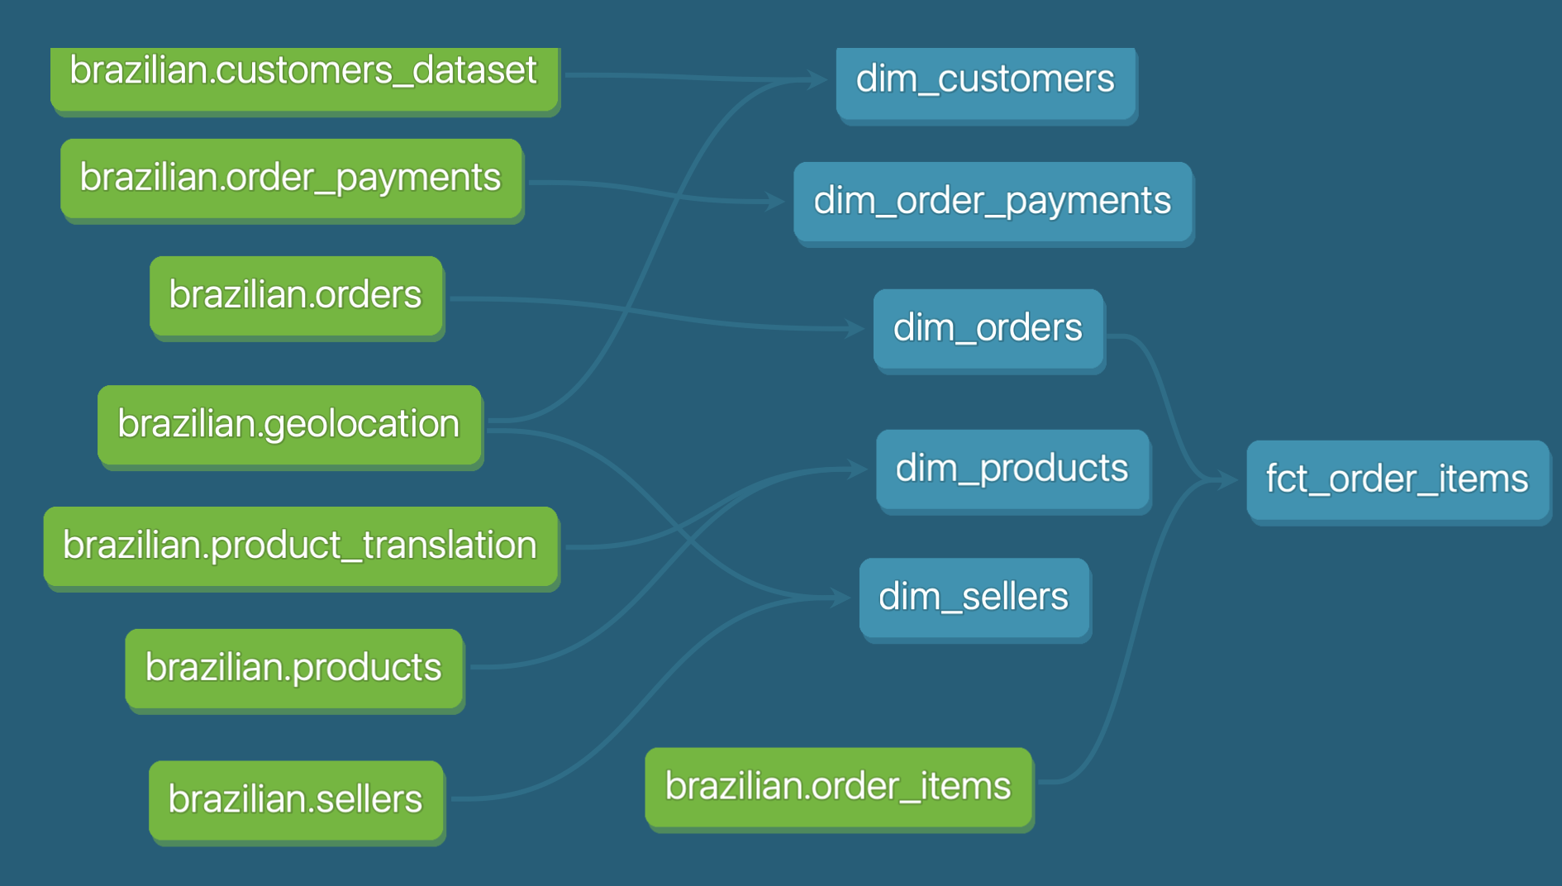
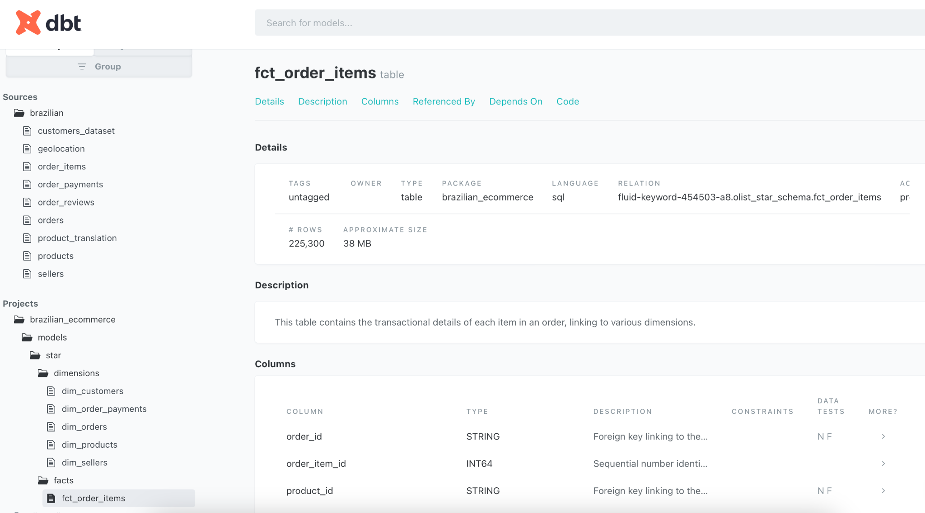
Dbt docs Lineage Graph

Slide 26
Pipeline Automation (Google Cloud Scheduler)

Slide 27
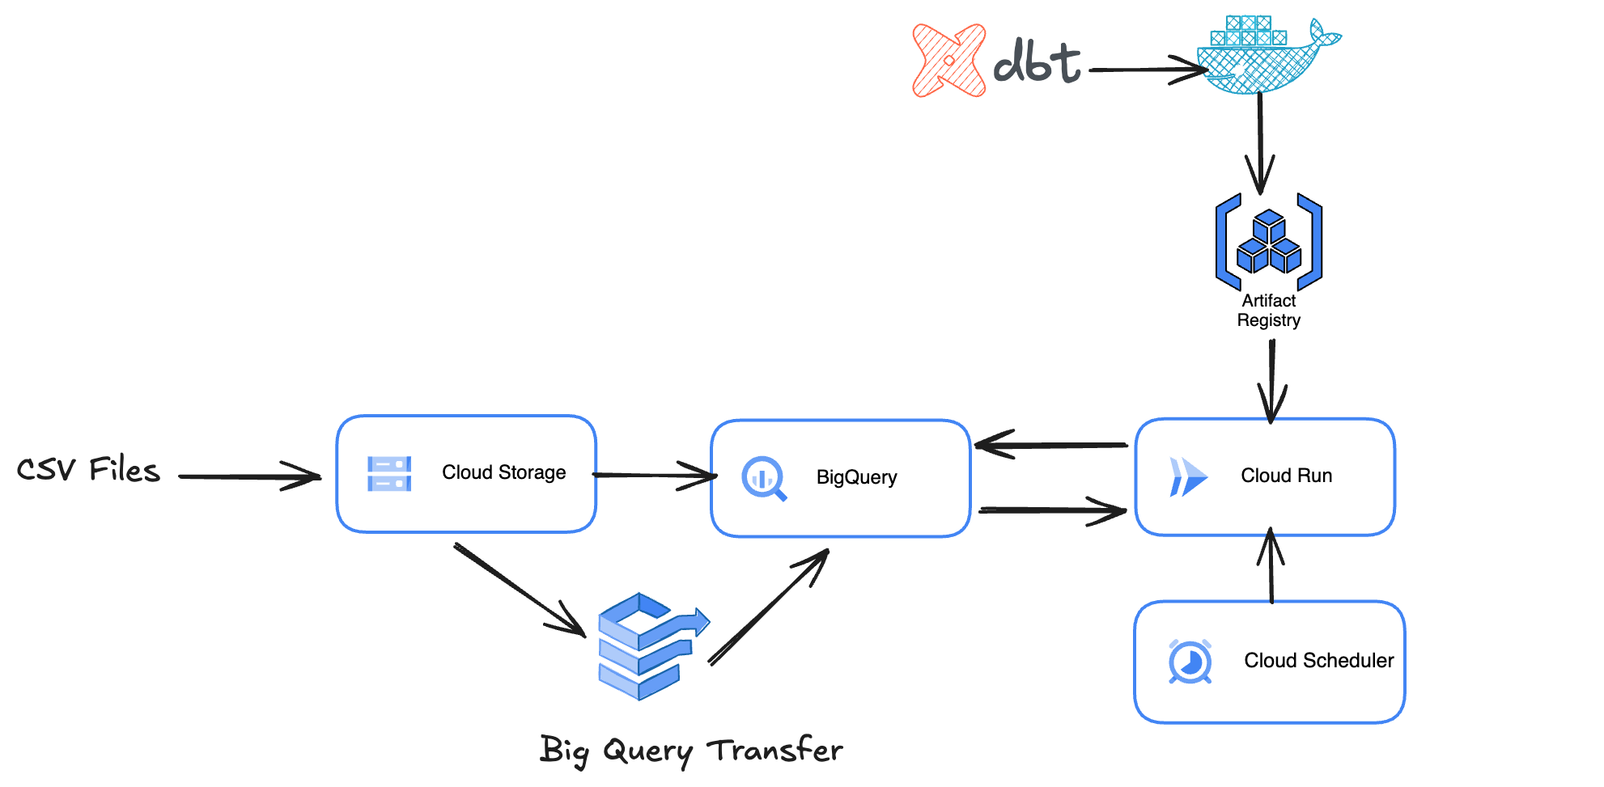

Slide 28
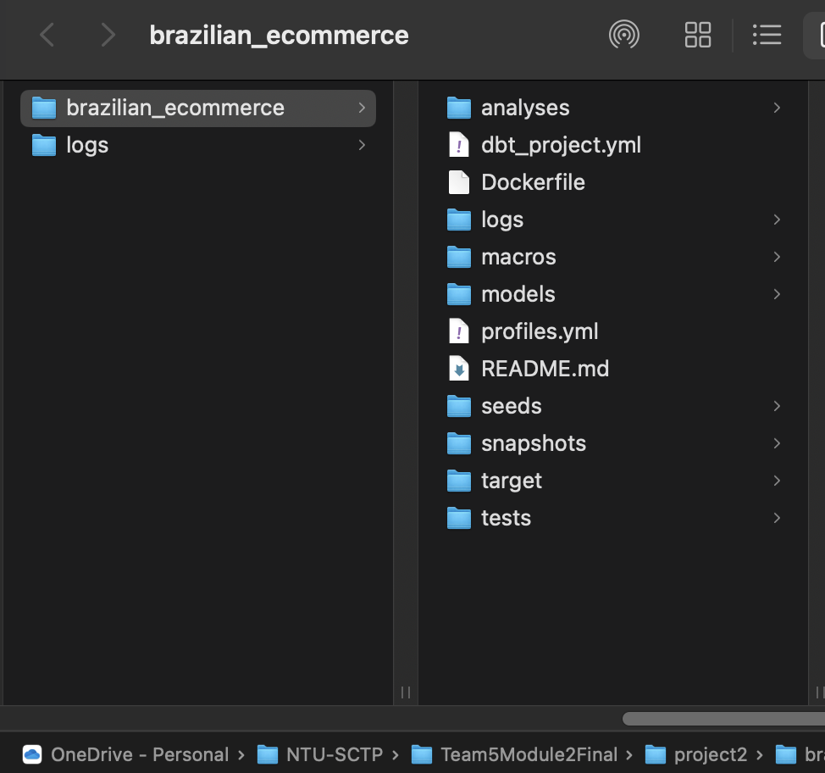
Create local docker image for DBT
Create DockerFile in DBT project folder
FROM python:3.10
# Setting the working directory
WORKDIR /usr/app
# Copying the project files
COPY models models
COPY tests tests
COPY snapshots snapshots
COPY macros macros
COPY dbt_project.yml dbt_project.yml
COPY profiles.yml /usr/app/profiles.yml
#COPY requirements.txt requirements.txt
#COPY packages.yml packages.yml
#COPY dbt_run.py /usr/app/
# Installing dependencies
RUN pip install --upgrade pip
RUN pip install dbt-databricks
RUN pip install dbt-bigquery
RUN dbt deps

Slide 29
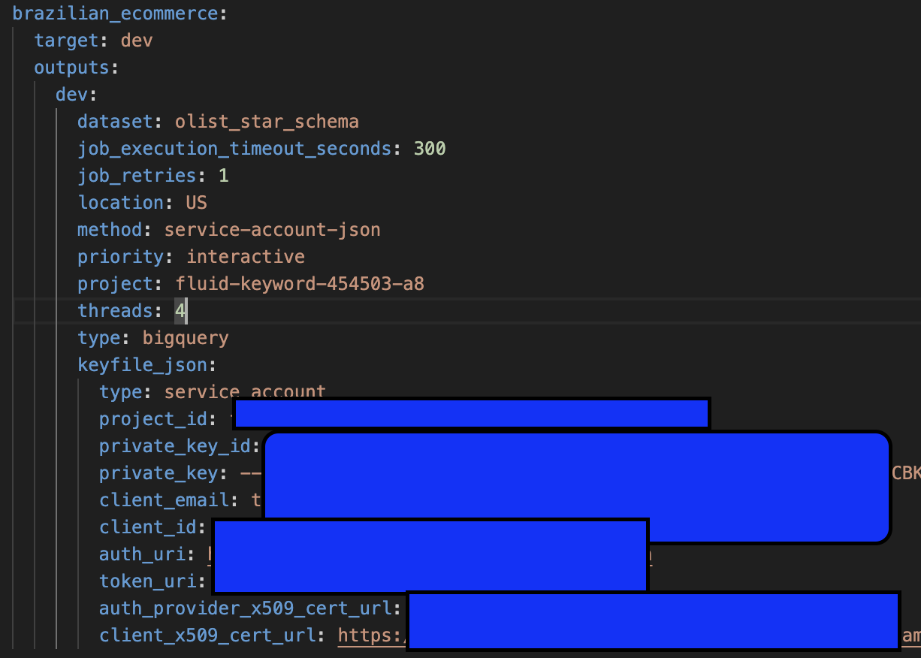
Create local docker image for DBT
2) copy profiles.yml to DBT folder and change the credential to use service account

Slide 30
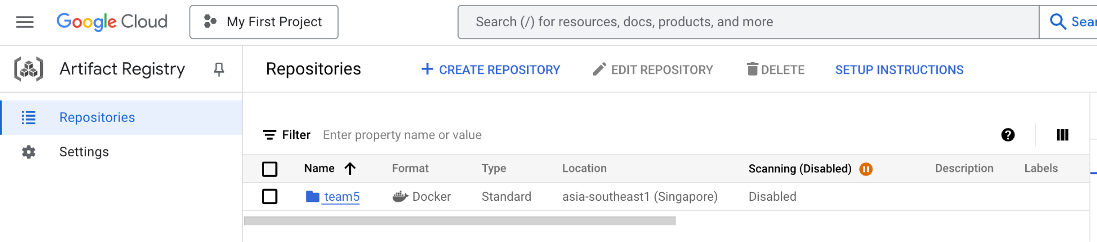
Create local docker image for DBT
3) Create artefact repository in GC

Slide 31
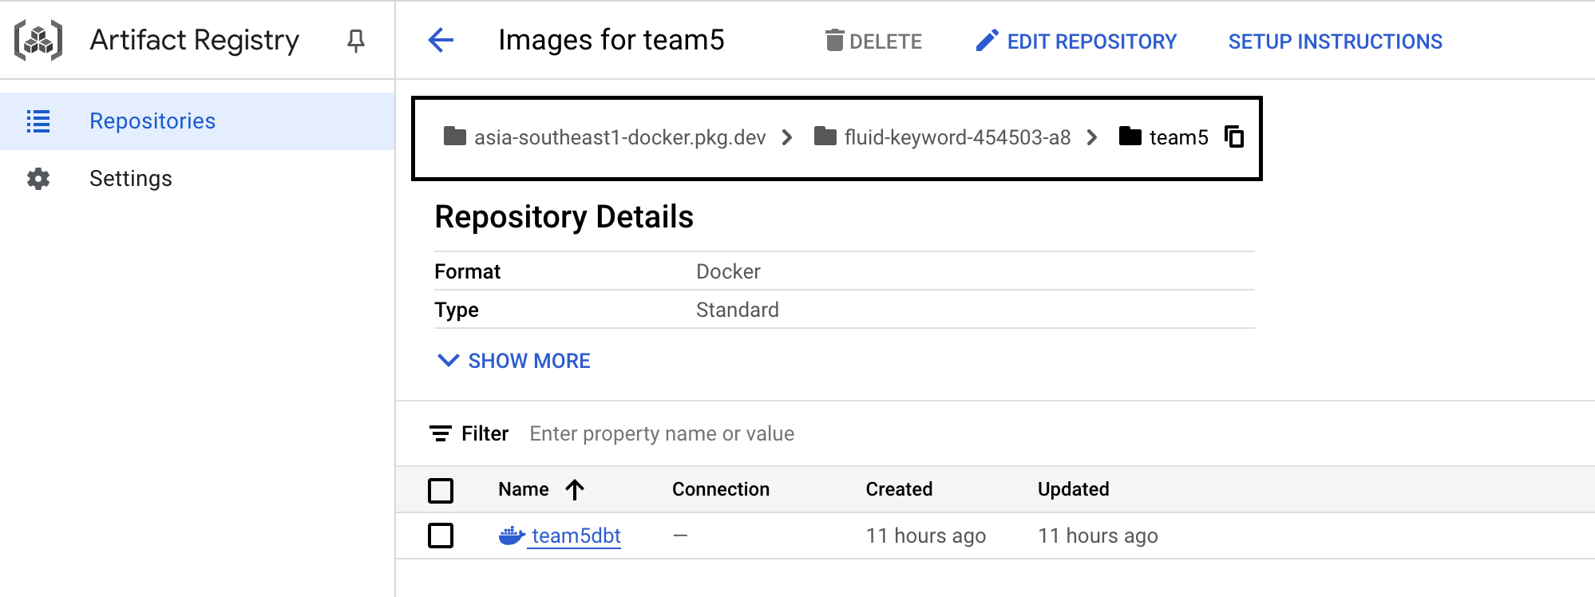
Create local docker image for DBT
4) Take note of the location name, project name and repository name
asia-southeast1-docker.pkg.dev/fluid-keyword-454503-a8/team5

Slide 32
Create local docker image for DBT
5) Build the docker image
docker build -t <your-artifact-registry-repository-url>:<tag> .
For Windows/Linux
docker build -t asia-southeast1-docker.pkg.dev/fluid-keyword-454503-a8/team5/team5dbt:latest .
For Apple Silicon
docker buildx build --platform linux/amd64 -t asia-southeast1-docker.pkg.dev/fluid-keyword-454503-a8/team5/team5dbt:latest .

Slide 33
Push docker image to GC Artifacts
6) Tag the image:
docker tag <image-id> <your-artifact-registry-repository-url>:<tag>
docker tag cffc9d2e1b7b asia-southeast1-docker.pkg.dev/fluid-keyword-454503-a8/team5/team5dbt:latest
7) Push the image to Artifacts
gcloud auth configure-docker
docker push asia-southeast1-docker.pkg.dev/fluid-keyword-454503-a8/team5/team5dbt:latest

Slide 34
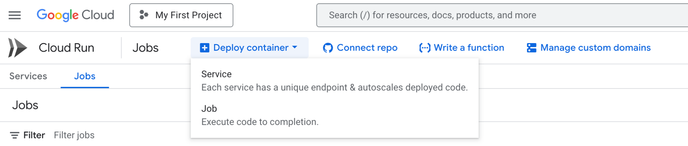
Create scheduled Jobs in GC Cloud run
Deploy container in Job

Slide 35
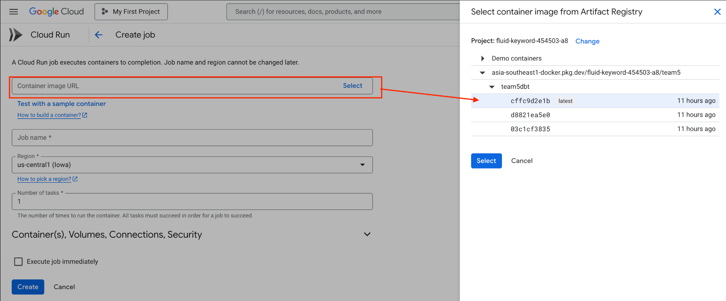
Create scheduled Jobs in GC Cloud run
2) Select the uploaded docker image

Slide 36
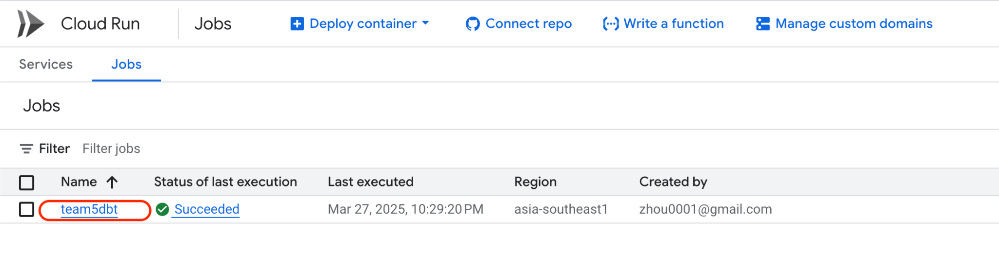
Create scheduled Jobs in GC Cloud run
3) Select the created job to edit the execution parameters

Slide 37
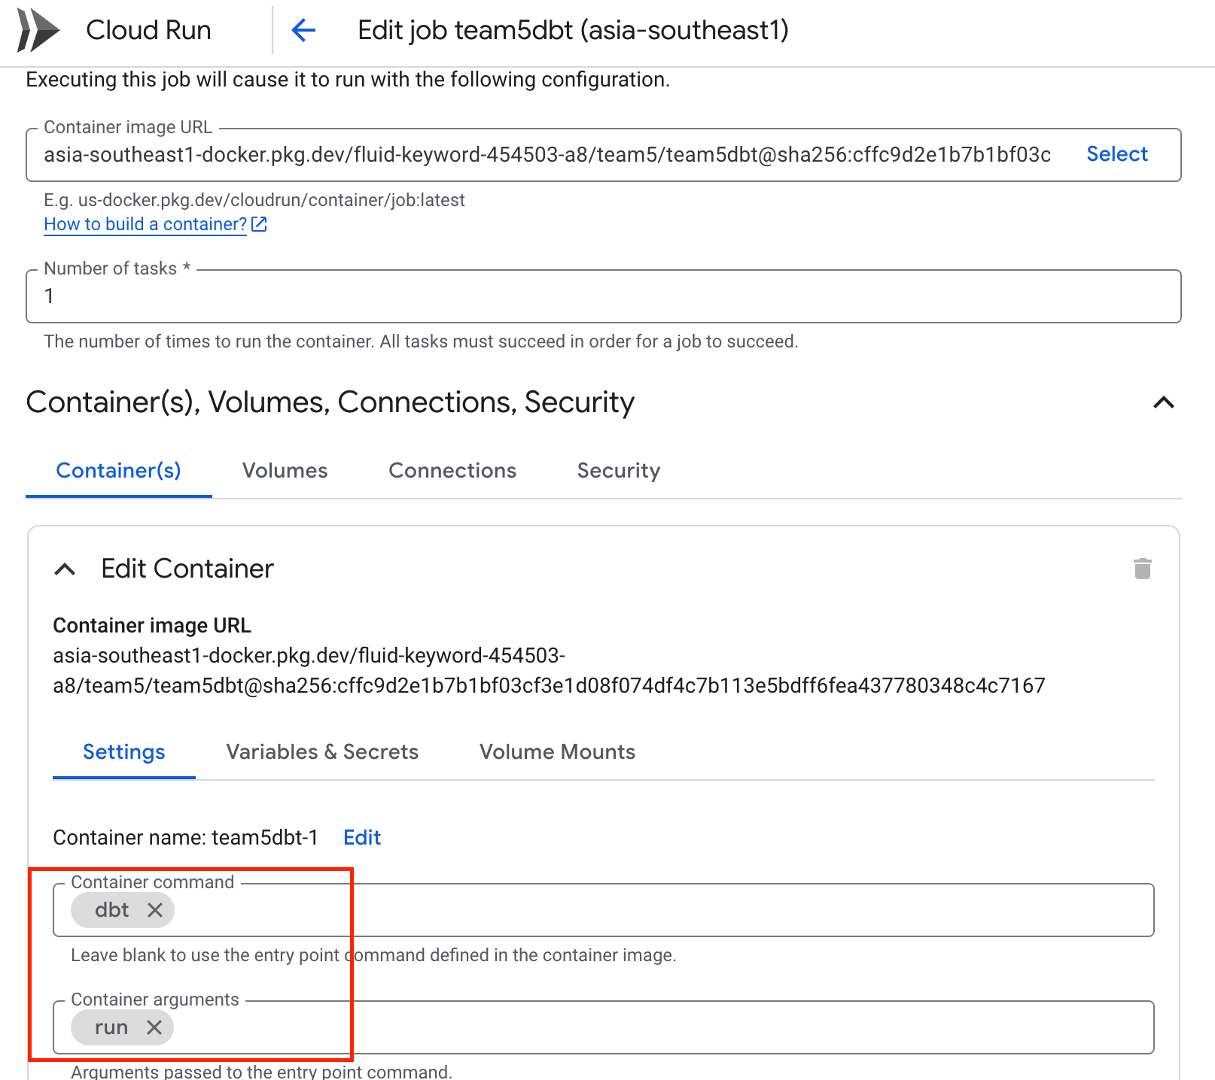
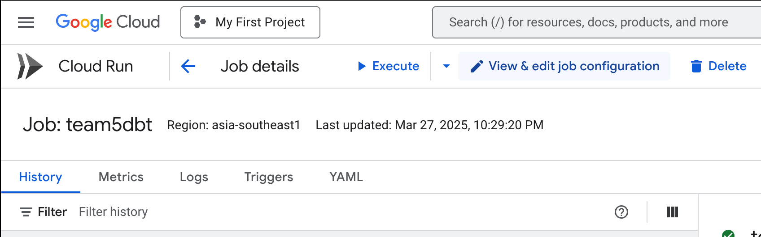
Create scheduled Jobs in GC Cloud run
4) Edit the parameters

Slide 38
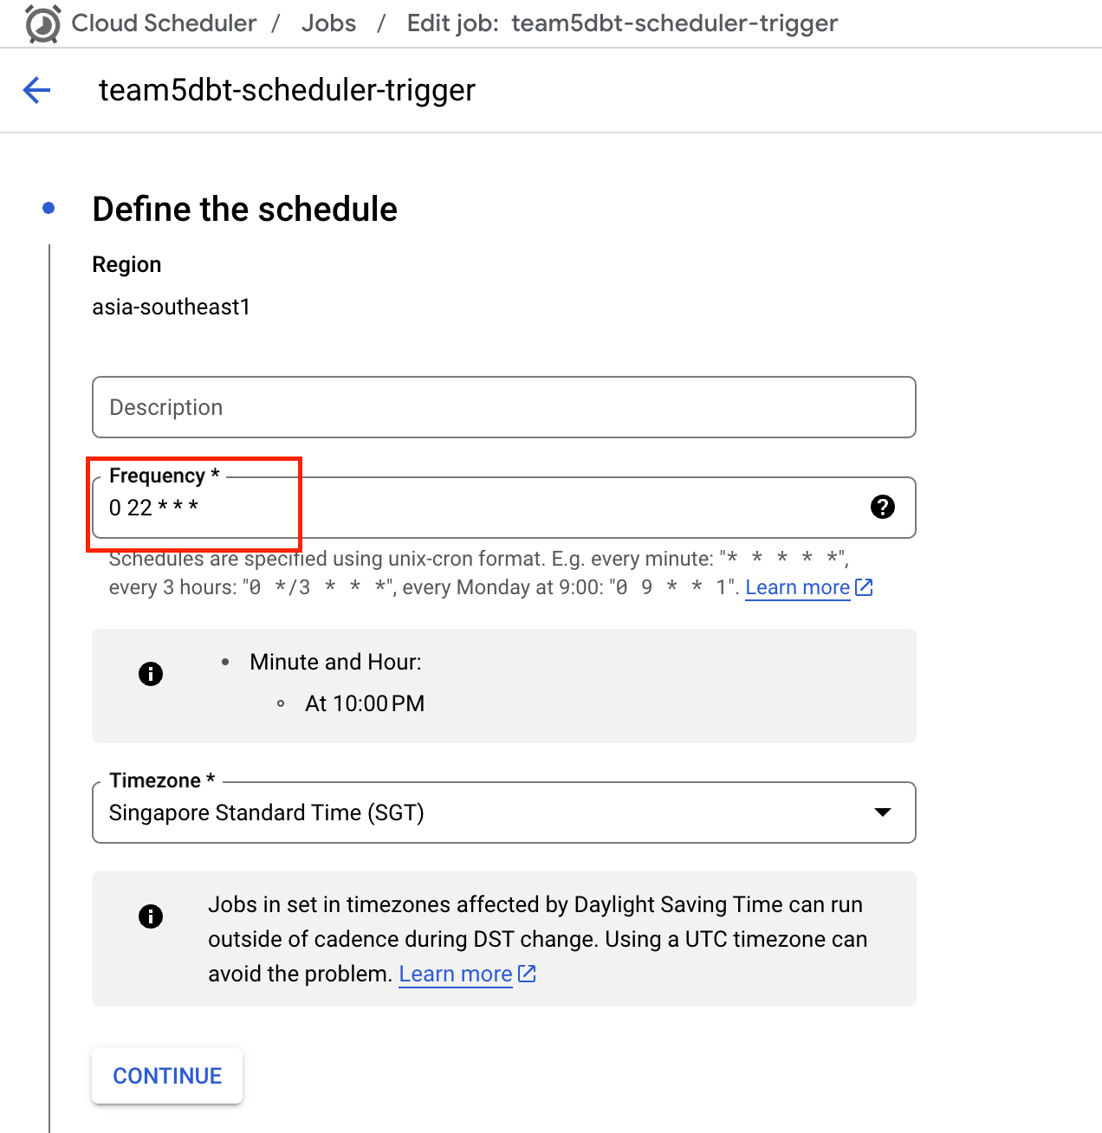
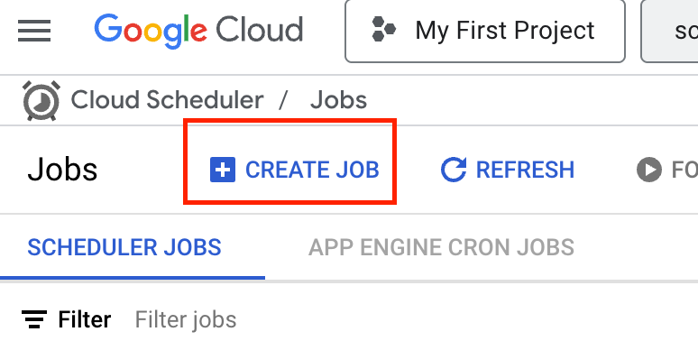
Create scheduled Jobs in GC Cloud run
5) Create schedule in Cloud Scheduler

Slide 39
Data Testing

Slide 40
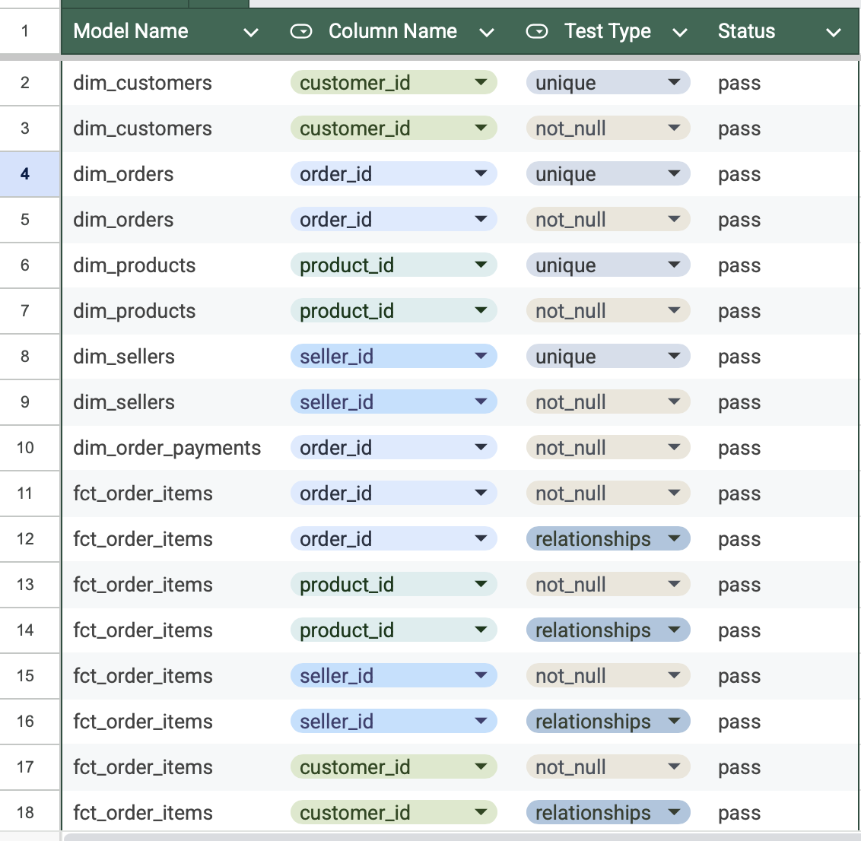
> DBT TEST
Test cases added in the respective yml files of the model tables and are executed when the dbt test command is run
Implemented tests for null values, duplicates, referential integrity

Slide 41
DBT Expectations
Test case | Model | Test Case | Test Results
Test whether the customer state is one of the valid Brazilian states | dim_customers | dbt_expectations.expect_column_values_to_be_in_set | passed
Test whether the English product category name is not null | dim_products | dbt_expectations.expect_column_values_to_not_be_null | passed
Test whether the order status is one of the valid order statuses | dim_orders | dbt_expectations.expect_column_values_to_be_in_set | passed
Test whether the seller state is one of the valid Brazilian states | dim_sellers | dbt_expectations.expect_column_values_to_be_in_set | Passed
Test whether the Portuguese product category name is not null | dim_products | dbt_expectations.expect_column_values_to_not_be_null | Passed
Test whether the order status is one of the valid order statuses | dim_orders | dbt_expectations.expect_column_values_to_be_in_set | Passed
Test whether the order purchase timestamp is a valid timestamp | dim_orders | dbt_expectations.expect_column_values_to_be_valid_timestamps | Passed
Test whether the order purchase timestamp is not in the future | dim_orders | dbt_expectations.expect_column_values_to_be_between (max_value: "CURRENT_TIMESTAMP()") | Passed
Test whether the payment type is one of the valid payment methods | dim_order_payments | dbt_expectations.expect_column_values_to_be_in_set | Passed
Test whether the number of payment installments is not negative | dim_order_payments | dbt_expectations.expect_column_values_to_be_between | Passed
Test whether the payment value is positive | dim_order_payments | dbt_expectations.expect_column_values_to_be_between | Passed
Test whether the price of the item is positive | fct_order_items | dbt_expectations.expect_column_values_to_be_between | Passed
Test whether the freight value of the item is positive | fct_order_items | dbt_expectations.expect_column_values_to_be_between | Passed

Slide 42
Exploratory Data Analysis (EDA)

Slide 43
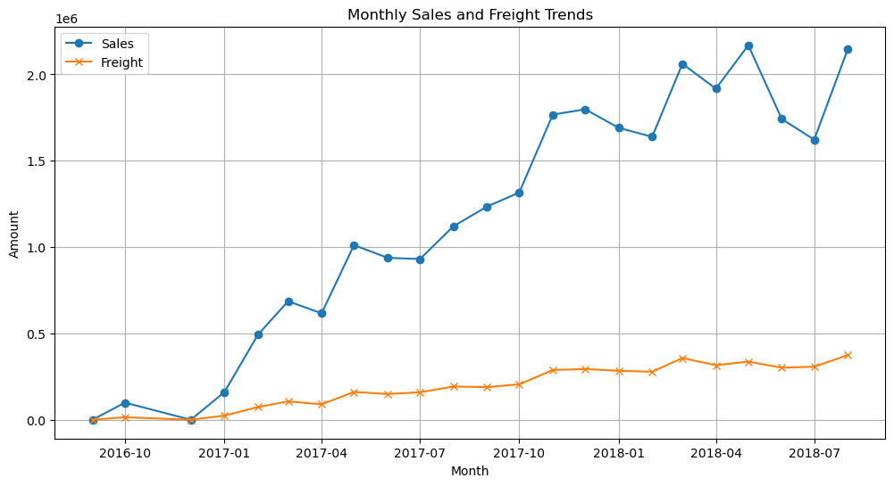
Analysis 1: Monthly Sales Trends
Business is on
exploding growth!

Slide 44
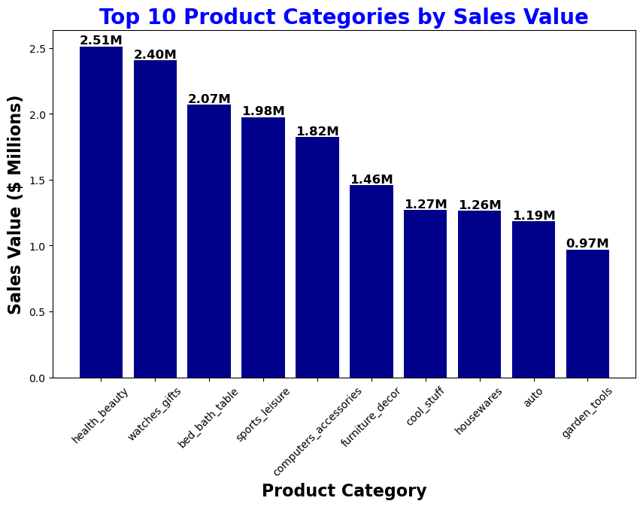
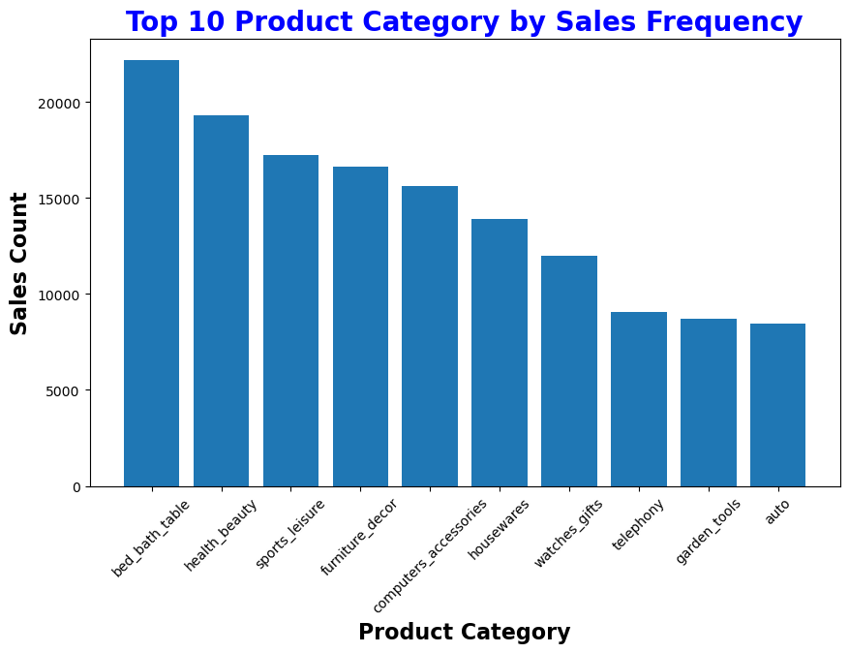
Analysis 2: Top-Selling Products
No electronics products in top 3
Surprise to see watches_gifts in the top 3 selling product by value

Slide 45
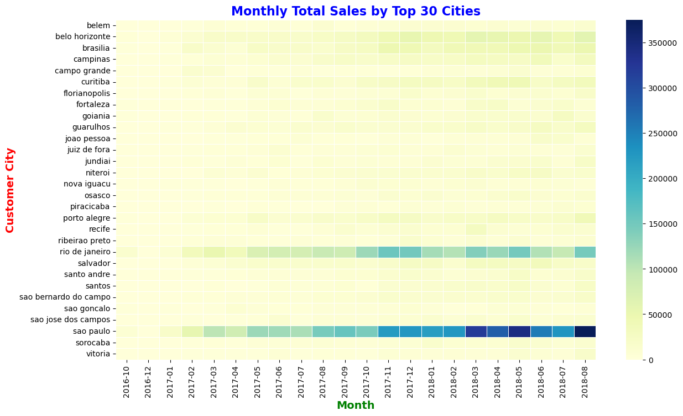
Analysis 3: Customer Segmentation by City
Sale are growing in these cities from 2017-sep.
Business are doing very good in 2nd major city
Business are doing very good in 2nd major city

Slide 46
Insights

Slide 47
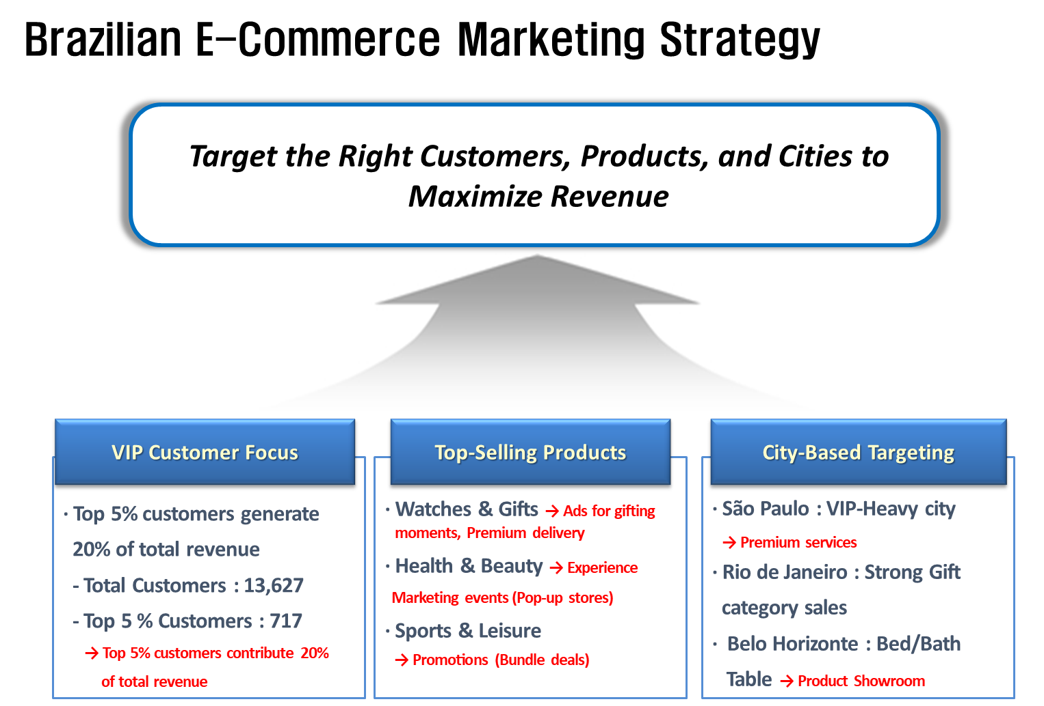

Slide 48
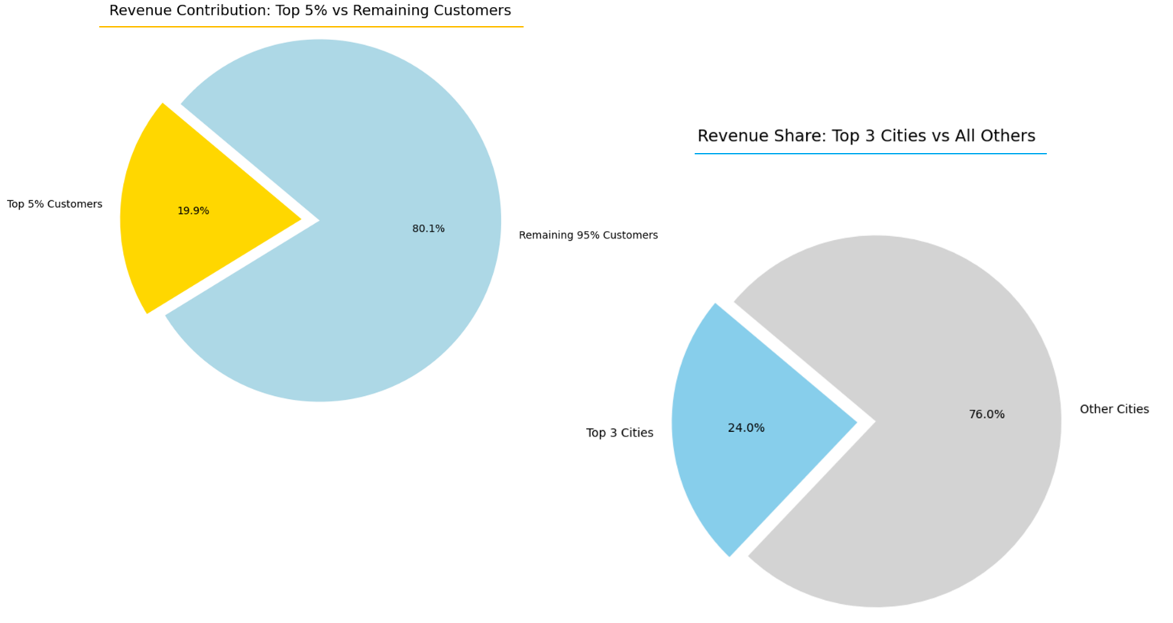

Slide 49
GitHub link
https://github.com/jochze-eng/Team5Module2Final

